Slide 1
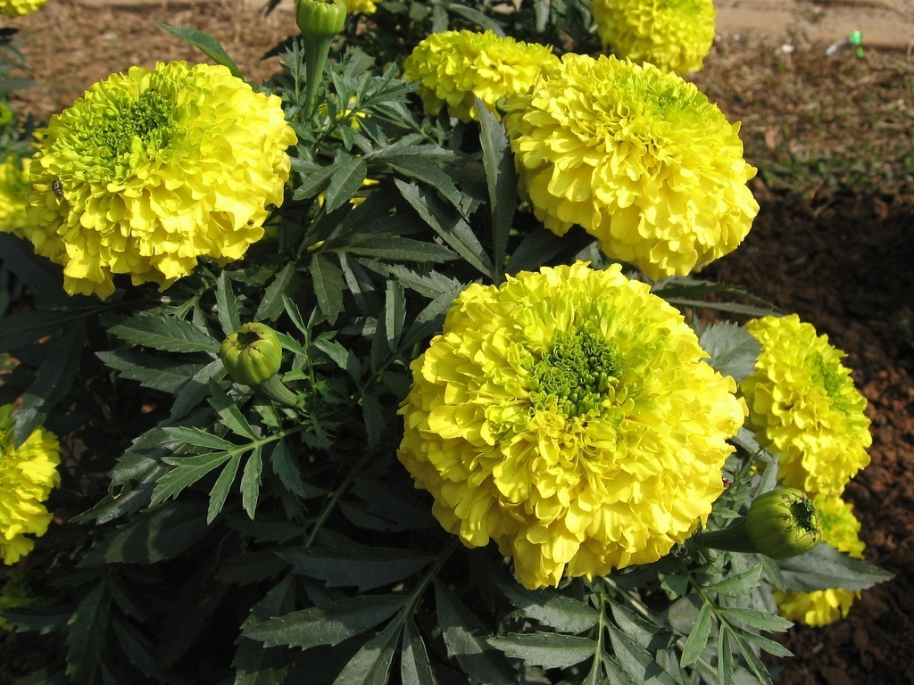
Welcome
Welcome

Slide 2
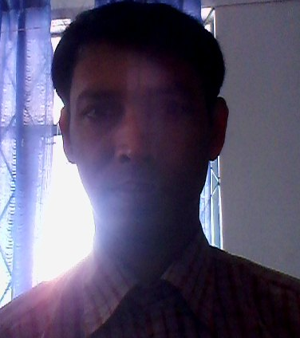
Teacher Introduction
Md. Jaherul Haque
Bandaikhara High school
Atrai, Naogaon.
ID No -17 .
Mobile No – 01731607403

Slide 3
Class: Nine
Subject: English 1st paper
Unit: Eight,
Lesson: One.
Time: 50 minute

Slide 4
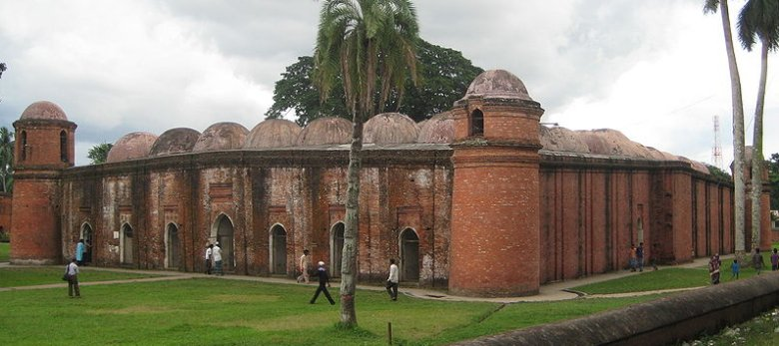

Slide 5
Today’s my Topic is‘’Shat Gambuj Mosque’’.

Slide 6
Objectives:
At the end of this lesson students will be able to-
1. Listening, Reading and understanding the New words of the story .
2. Ask and answer questions.
3. Describe a place .

Slide 7
Individual work .
What is the name of this building ?
Shat Gambuj Mosque

Slide 8

Answer: (i) It is a mosque .

Slide 9
Pair work .
(i) What do you know about it?

Slide 10
Solution
It is a big mosque built by khan Jahan Ali.

Slide 11
Group work
Describe a Historical place.

Slide 12
Answer
It is a big mosque .It is situated by town of Bagerhat. The mosque is unique in the sense that it has 60 pillars that support the roof, with77 domes. The floor of the mosque is made of brick .

Slide 13
Evaluation
Where is shat Gambuj mosque ?
(a) Dhaka (b) Comilla
(c) Bagerhat (d) Rajshahi
√

Slide 14
How many domes on the mosque ?
(a) 70 (b) 67
(c) 87 (d) 77 .
√

Slide 15
Home work
Write a paragraph about shat Gambuj mosque .

Slide 16
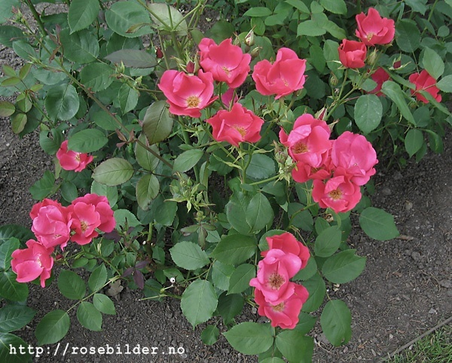
THANk YOU

